Slide 1

North South University
Department of Electrical & Computer Engineering
Project Presentation
Summer 2020
Project Title : Fake News Detection
Using Logistic Regression, SVM and Naive Bayes
Submitted By:
Name : Sazzad Hossain
ID : 1610139042
Course : CSE445
Section : 01
Course Instructor :
Dr. Mohammad Ashrafuzzaman Khan

Slide 2

The Problem Statement
The problem is identify Fake news from Real news.
We solved this problem by developing machine learning programs using different algorithms to distinguish fake and true news based on content acquired.

Slide 3
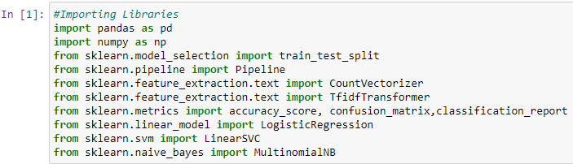

The First Thing We Tried
The dataset we used is taken from Kaggle. The data set has two CSV files containing true and fake news. Each CSV have Title, text, subject and date attributes. There are 21417 true news data and 23481 fake news data given in the true and fake CSV files respectively.
After importing the libraries, we read the CSV files in the program.
First, we will import all the required libraries.

Slide 4
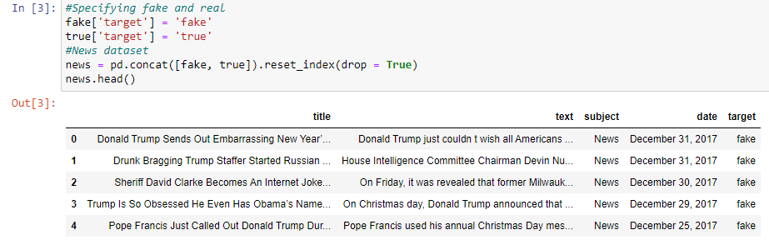
The First Thing We Tried
Here, we will add fake and true labels as the target attribute with both the datasets and create our main data set that combines both fake and real datasets.
After specifying the main dataset, we will define the train and test data set by splitting the main data set. We have kept 20% of the data for testing the classifiers. This can be adjusted accordingly.

Slide 5
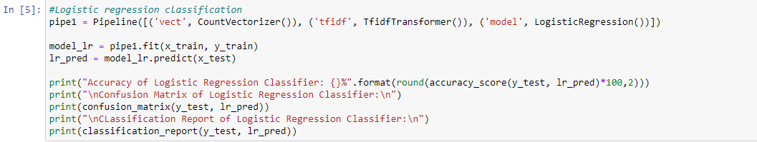
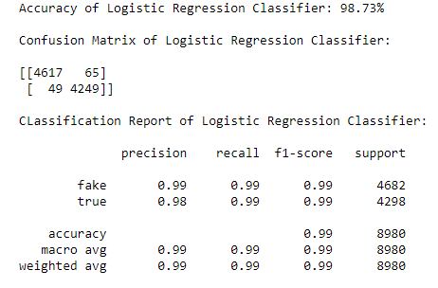
The First Thing We Tried
At first, we classified the news text using the Logistic Regression model and evaluate its performance using evaluation matrices.
The Results We Got
We got 98.73% accuracy for Logistic Regression Classifier.
From Confusion Matrix of Logistic Regression Classifier we got: True Positive = 4617,False Positive = 49,False Negative = 65, True Negative = 4249
For fake news we got, precision = 0.99, recall=0.99, f1-score = 0.99
For true news we got, precision = 0.98, recall=0.99, f1-score = 0.99

Slide 6
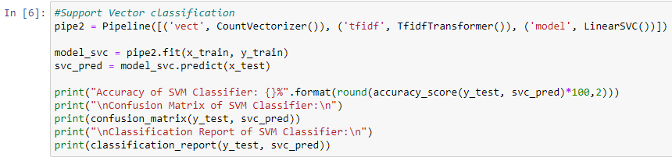
Motivation To Use Other Methods
The primary motivation to use other methods was to figure out the performance of different algorithms and compare the outcomes of all methods.
Improvement We Got From Other Methods
After performing the classification using the logistic regression model, we classified the news text using the Support Vector Classifier model and evaluated its performance using evaluation matrices.

Slide 7
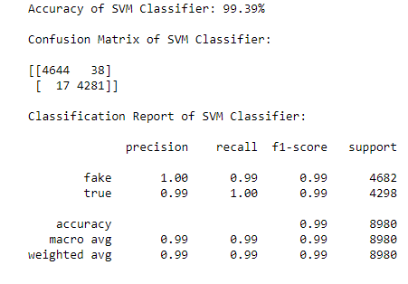
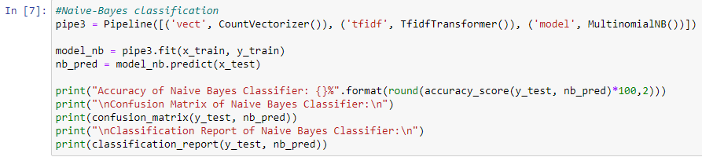
Improvement We Got From Other Methods
The Results We Got For SVM:
We got 99.39% accuracy for Support Vector Machine Classifier.
From Confusion Matrix of Support Vector Machine Classifier we got: True Positive = 4644, False Positive = 17, False Negative = 38, True Negative = 4281.
For fake news we got, precision = 1.00, recall=0.99, f1-score = 0.99
For true news we got, precision = 0.99, recall=1.00, f1-score = 0.99
Finally, we classified the news text using the Naive Bayes Classifier model and evaluated its performance using evaluation matrices.

Slide 8
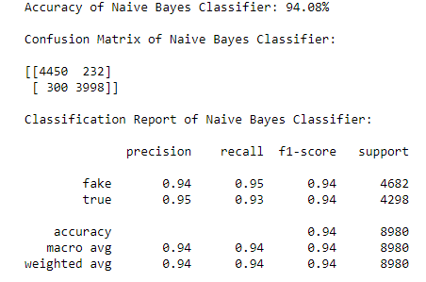
Improvement We Got From Other Methods
The Results We Got For Naive Bayes Classifier:
We got 94.08% accuracy for Naive Bayes Classifier.
From Confusion Matrix of Naive Bayes Classifier we got: True Positive = 4450, False Positive = 300, False Negative = 232, True Negative = 3998.
For fake news we got, precision = 0.94, recall=0.95, f1-score = 0.94
For true news we got, precision = 0.95, recall=0.93, f1-score = 0.94
Finally, as we can analyze from the accuracy scores, confusion matrices and the classification reports of all the three models, we can conclude that that the Support Vector Classifier has better result than the Logistic Regression model and the Naive Bayes model in this task. The Support Vector classifier has given about 100% accuracy in classifying the fake news texts.

Slide 9
Model Selection Method
Among three common resampling model selection methods we used Random train_test_split.
Improvement By Using Model Selection Technique
train_test_split is a function in Sklearn model selection for splitting data arrays into two subsets: for training data and for testing data. With this function, we do not need to divide the dataset manually. By default, Sklearn train_test_split will make random partitions for the two subsets. However, we can also specify a random state for the operation.
Using the same dataset for both training and testing leaves room for miscalculations, thus increases the chances of inaccurate predictions. The train_test_split function allows us to break a dataset with ease while pursuing an ideal model.

Slide 10
Things We Learn From The Project
Distinguish between click bait, actual fake news and real news.
Content based classification is just a part of the whole picture.
The loss to value of information in a real scenario for news is very high.
Lack of clean data can slow down our work progress.
In Over fitting situation when a model shows almost perfect accuracy when handling training data. This situation happens when the model has a complex set of rules. When a model is over fitting, it can be inaccurate when handling new data.
Under fitting is when a model doesn't fit the training data due to sets of rules that are too simple. You can't rely on an under fitting model to make an accurate prediction.

Slide 11
The Sources We Used, To Do The Project
[1] https://www.educative.io/edpresso/what-is-pandas-in-python
[2] https://scikit-learn.org/stable/modules/generated/sklearn.model_selection.train_test_split.html
[3] https://scikit-learn.org/stable/modules/generated/sklearn.pipeline.Pipeline.html
[4] https://scikit-learn.org/stable/modules/generated/sklearn.feature_extraction.text.CountVectorizer.html
[5] https://scikit-learn.org/stable/modules/generated/sklearn.feature_extraction.text.TfidfTransformer.html
[6] https://scikit-learn.org/stable/modules/generated/sklearn.metrics.accuracy_score.html
[7] https://scikit-learn.org/stable/modules/generated/sklearn.metrics.confusion_matrix.html
[8] https://www.kaggle.com/clmentbisaillon/fake-and-real-news-dataset
[9] https://machinelearningmastery.com/a-gentle-introduction-to-model-selection-for-machine-learning/
Conclusion
There are more than millions of news contents published on the internet every day. If we include the social media then this figure will be increased in multiples. Nowadays, the internet is becoming the biggest source of spreading fake news. A mechanism is required to identify fake news published on the internet so that the readers can be warned accordingly. By Machine Learning we can detect fake news and can solve this problem.

Slide 12
Thank You
Models | Accuracy
Logistic Regression Classifier | 98.73%
Support Vector Machine Classifier | 99.39%
Naive Bayes Classifier | 94.08%

